Slide 1
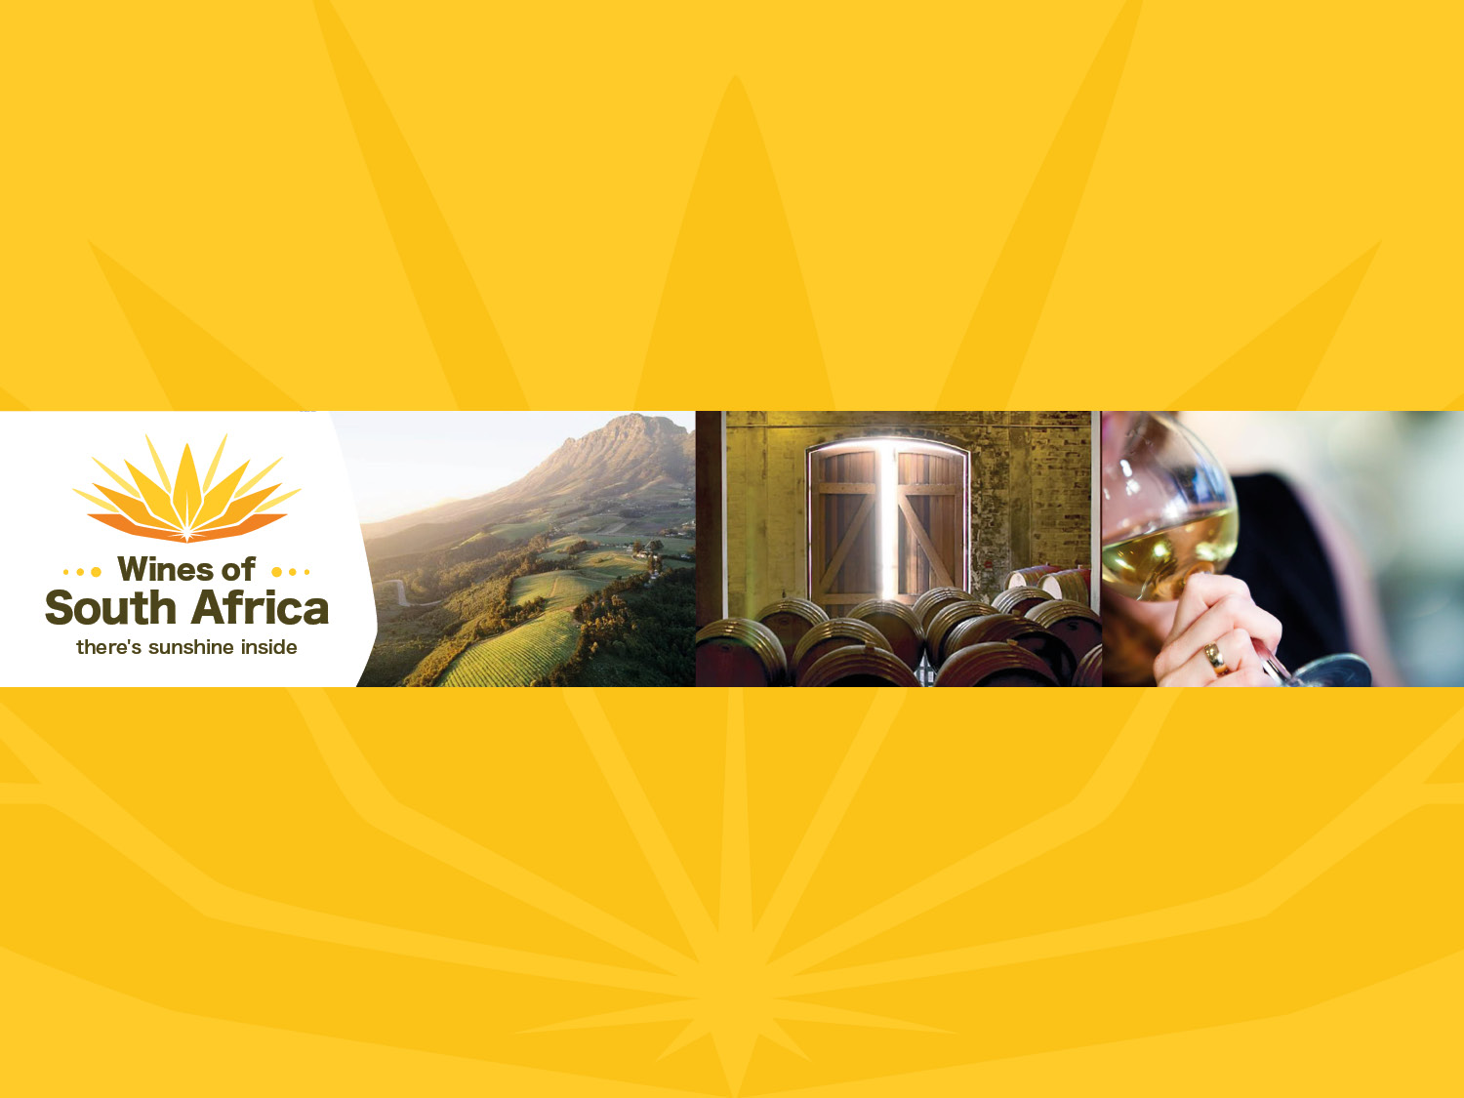
SAUVIGNON BLANC

Slide 2
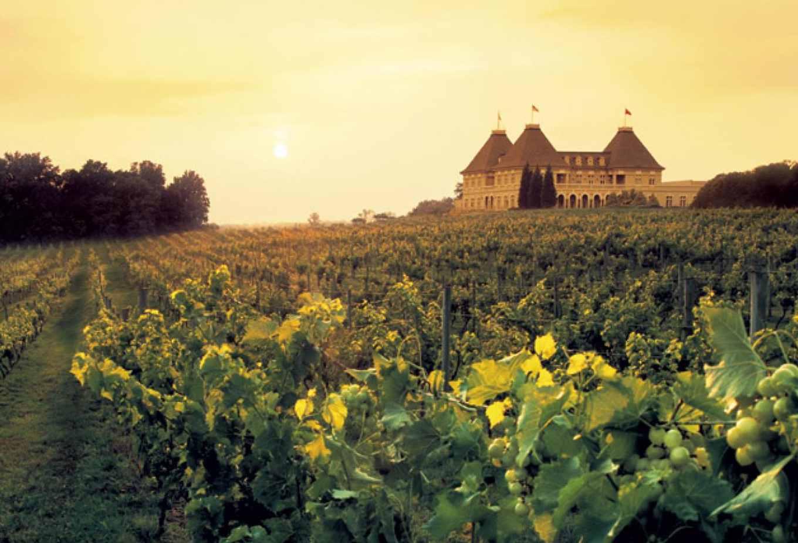
Notes:
Extensively planted in France in the 18th century, Sauvignon Blanc has now regained popularity and considerably increased its share of plantings globally.

Slide 3
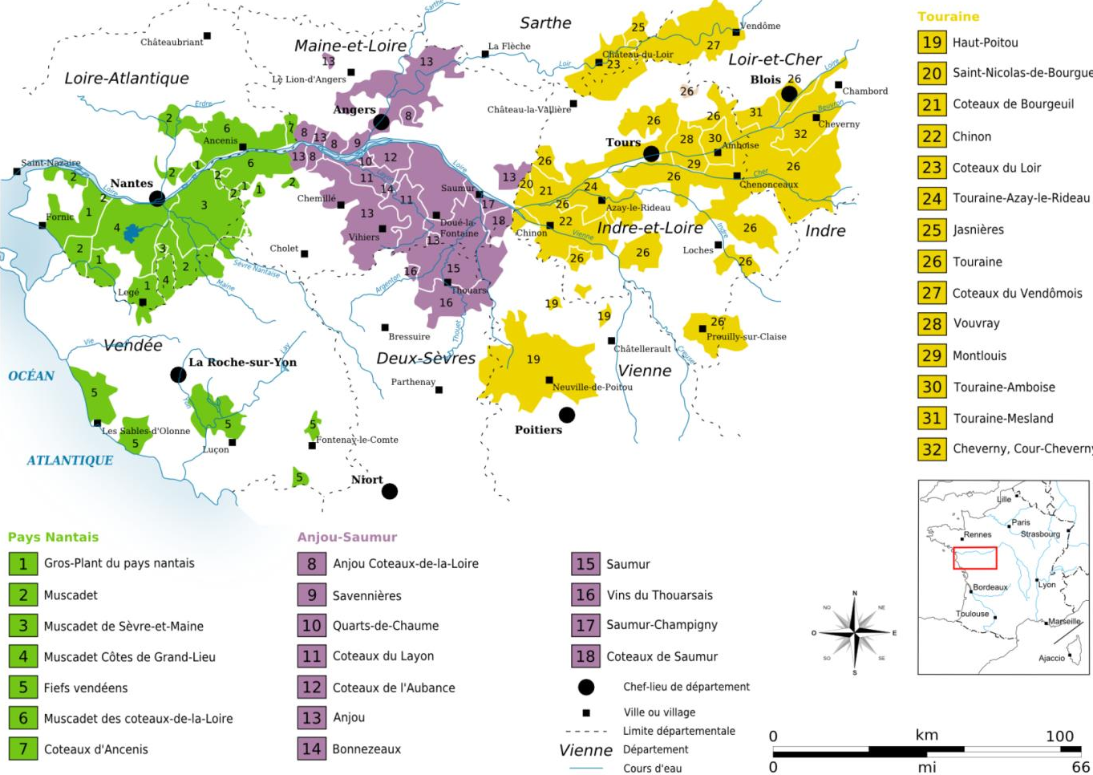
Notes:
Sauvignon is most readily associated with the eastern Loire region, which is known for its classic crisp, dry Sancerre and smoky Pouilly-Fumé.

Slide 4
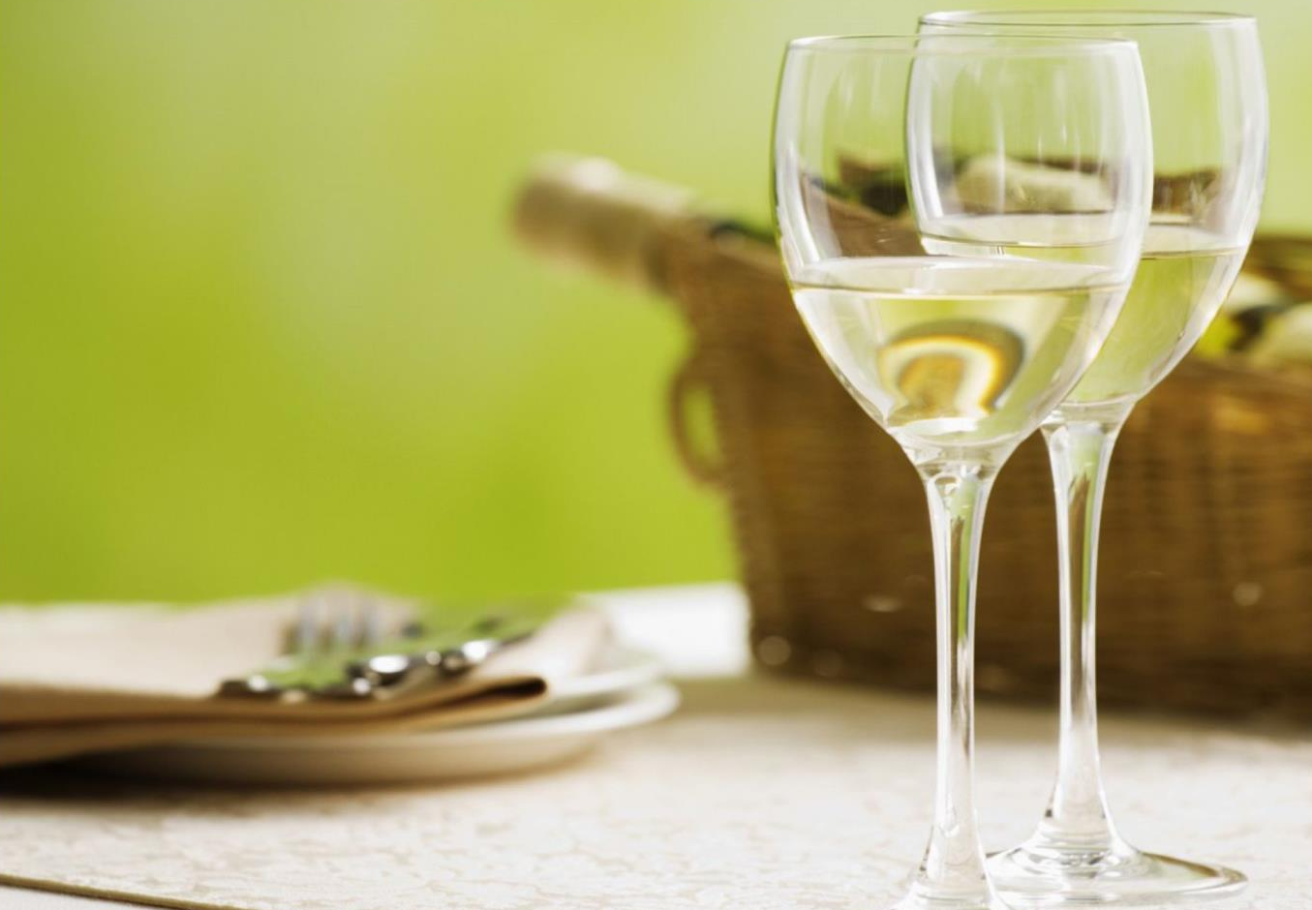
Notes:
In combination with Sémillon, these grapes also produce some of the most exceptional white wines of Bordeaux, including the driest Graves and the sweetest Sauternes.

Slide 5
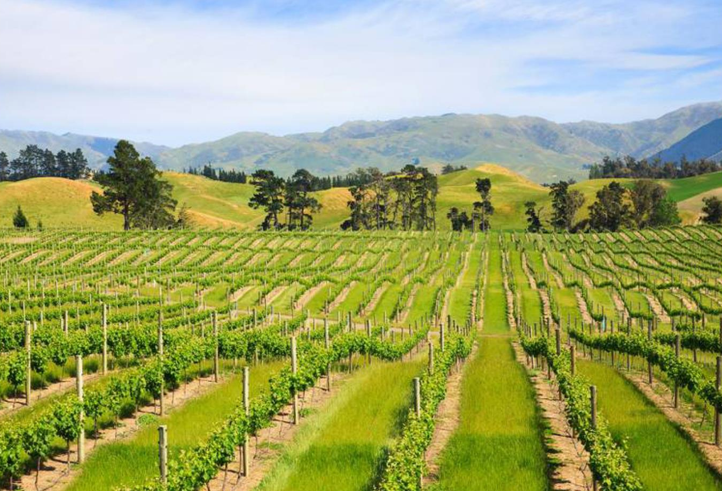
Notes:
In the 1980s, the distinctive Sauvignons from New Zealand helped restore the variety’s fashionability and put the country on the world wine map.

Slide 6
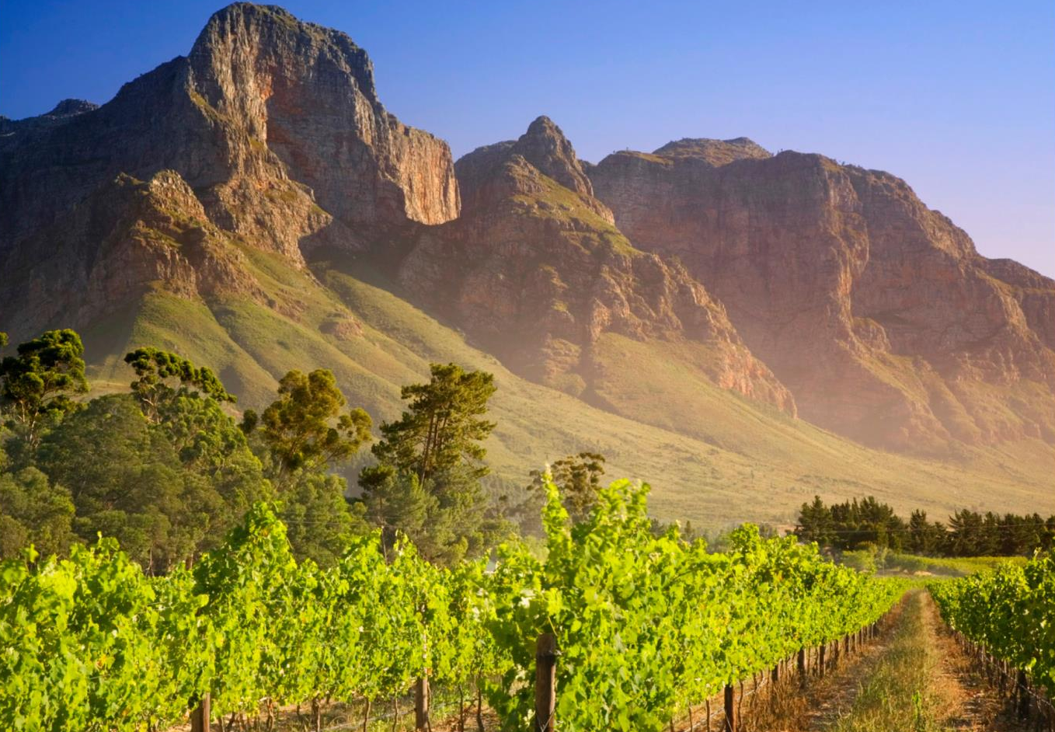
Notes:
In South Africa, plantings were relatively small in the 1920s but increased from around 1980.

Slide 7
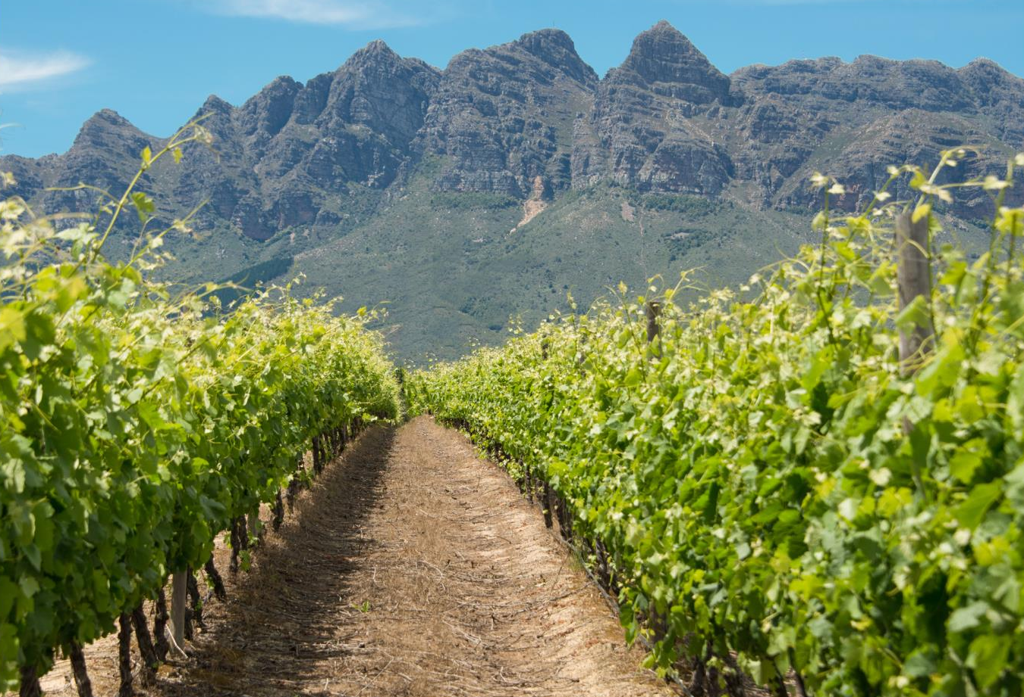
Notes:
Much research has been done into the effects of sunlight, canopy management and site selection on the flavour composition of the wines.

Slide 8
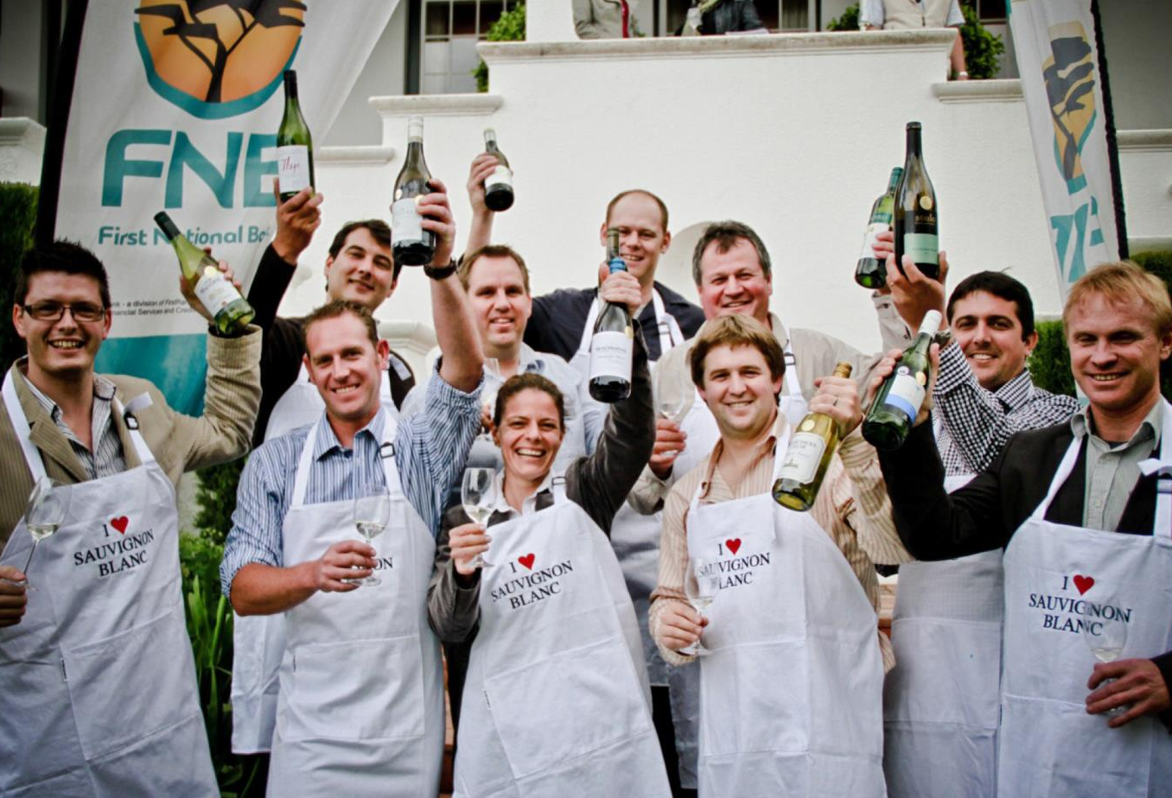
Notes:
The annual Top 10 Sauvignon Blanc Competition has been held under the auspices of the Sauvignon Blanc Interest Group (SBIG), now called Sauvignon Blanc South Africa, since 2011. Visit www.sauvignonblanc.com for more information.

Slide 9
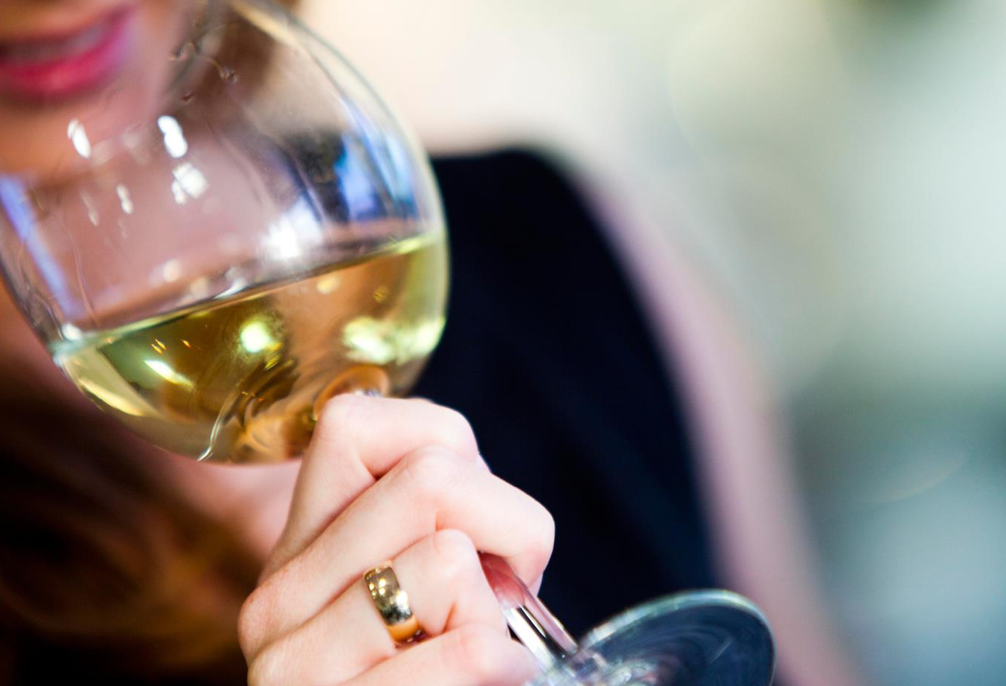
Notes:
Today, South African wines made from this variety are being recognised internationally for their quality and complexity.

Slide 10
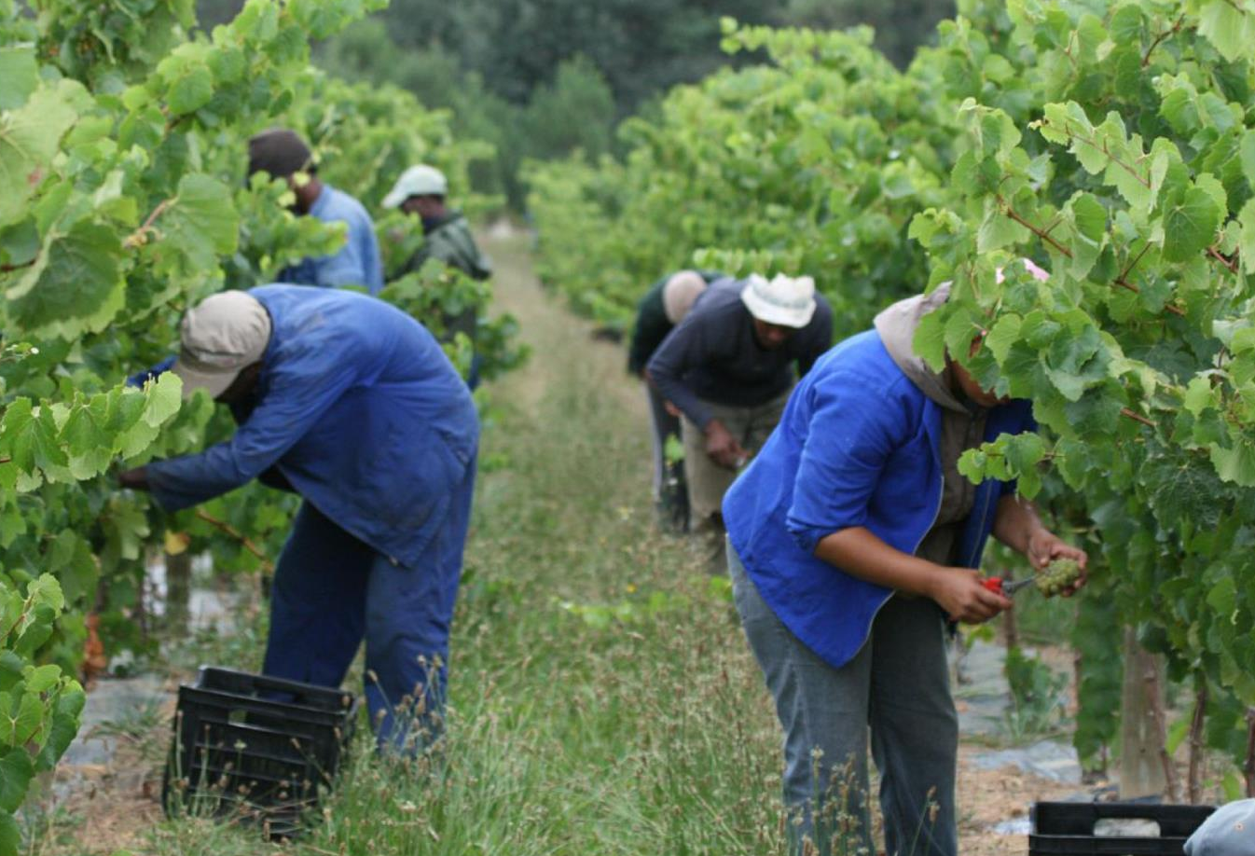
Notes:
A wide variety of clones are available locally and some producers plant several different clones to achieve the desired flavour profile and complexity in the resultant wine.

Slide 11
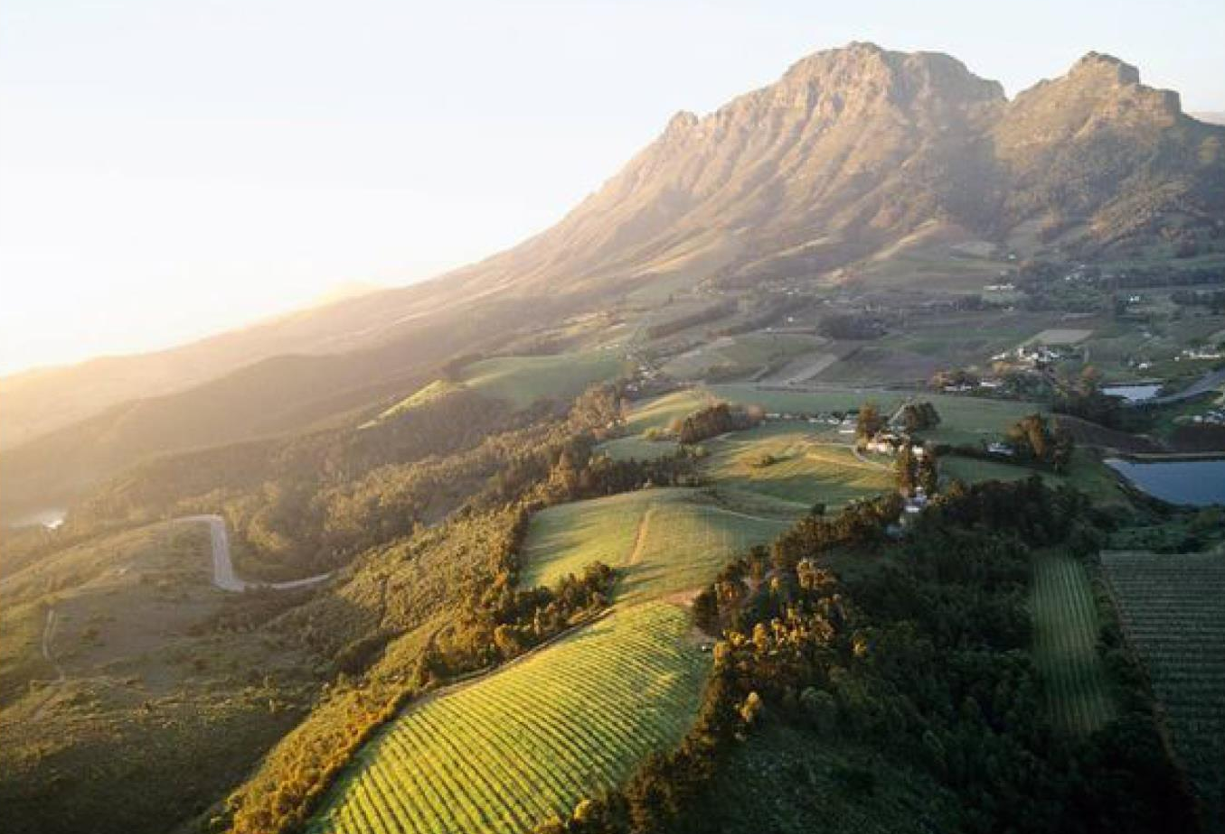
Notes:
Sauvignon Blanc is the second most planted white-wine variety in South Africa, with total plantings at the end of 2025 accounting for 10 442 ha (12.1% of the national vineyard).

Slide 12
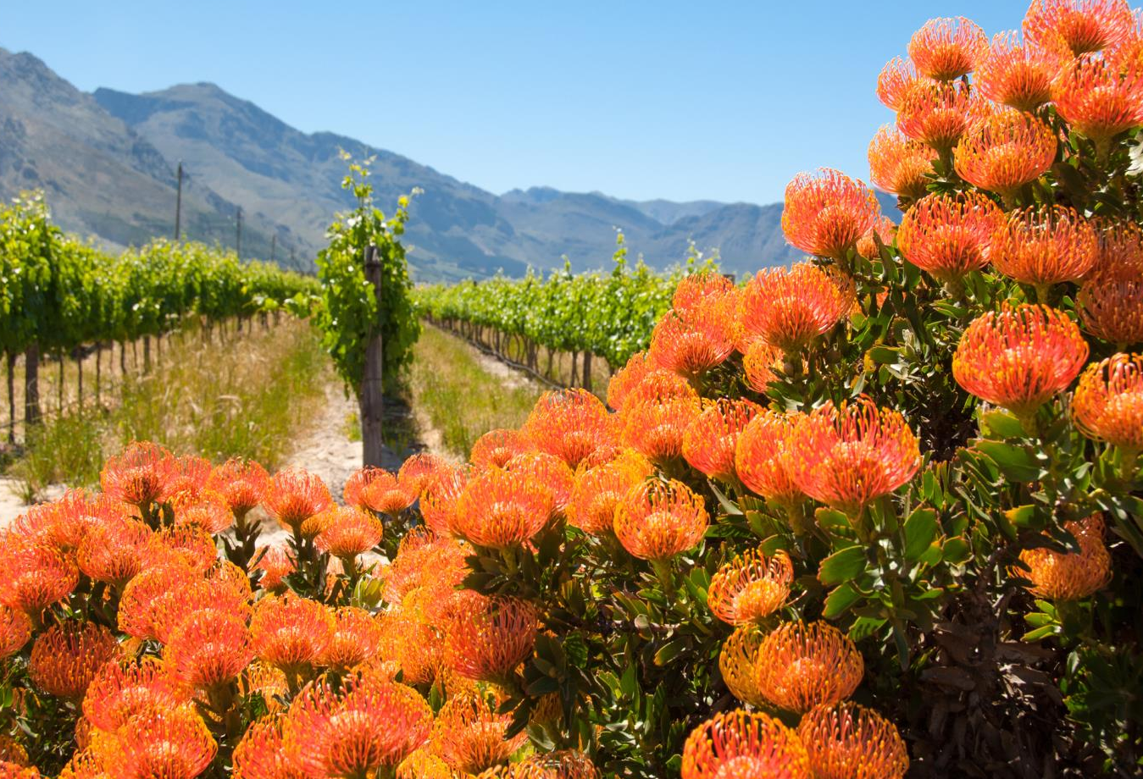
Notes:
Sauvignon is produced in most of South Africa’s diverse winegrowing regions. For Sauvignon that displays pure, clean fruit and fresh acidity, the production areas of Cape Point, Constantia, Darling, Durbanville, Elgin and Elim, as well as the as yet unclassified Schapenberg in the Stellenbosch district lead the way.

Slide 13
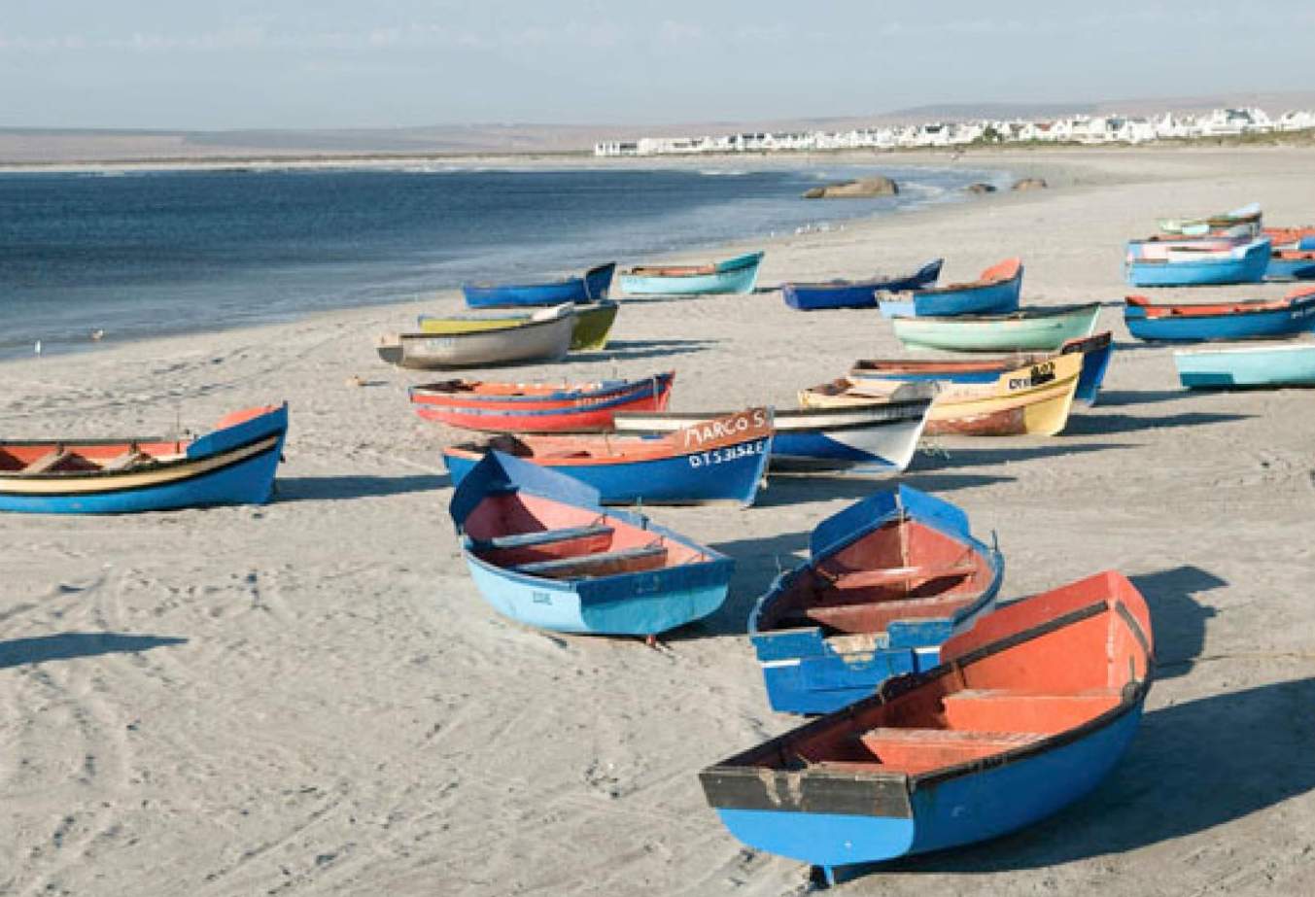
Notes:
Fine examples are also made in pockets on the West Coast, including Cederberg, Bamboes Bay and Lambert’s Bay.

Slide 14
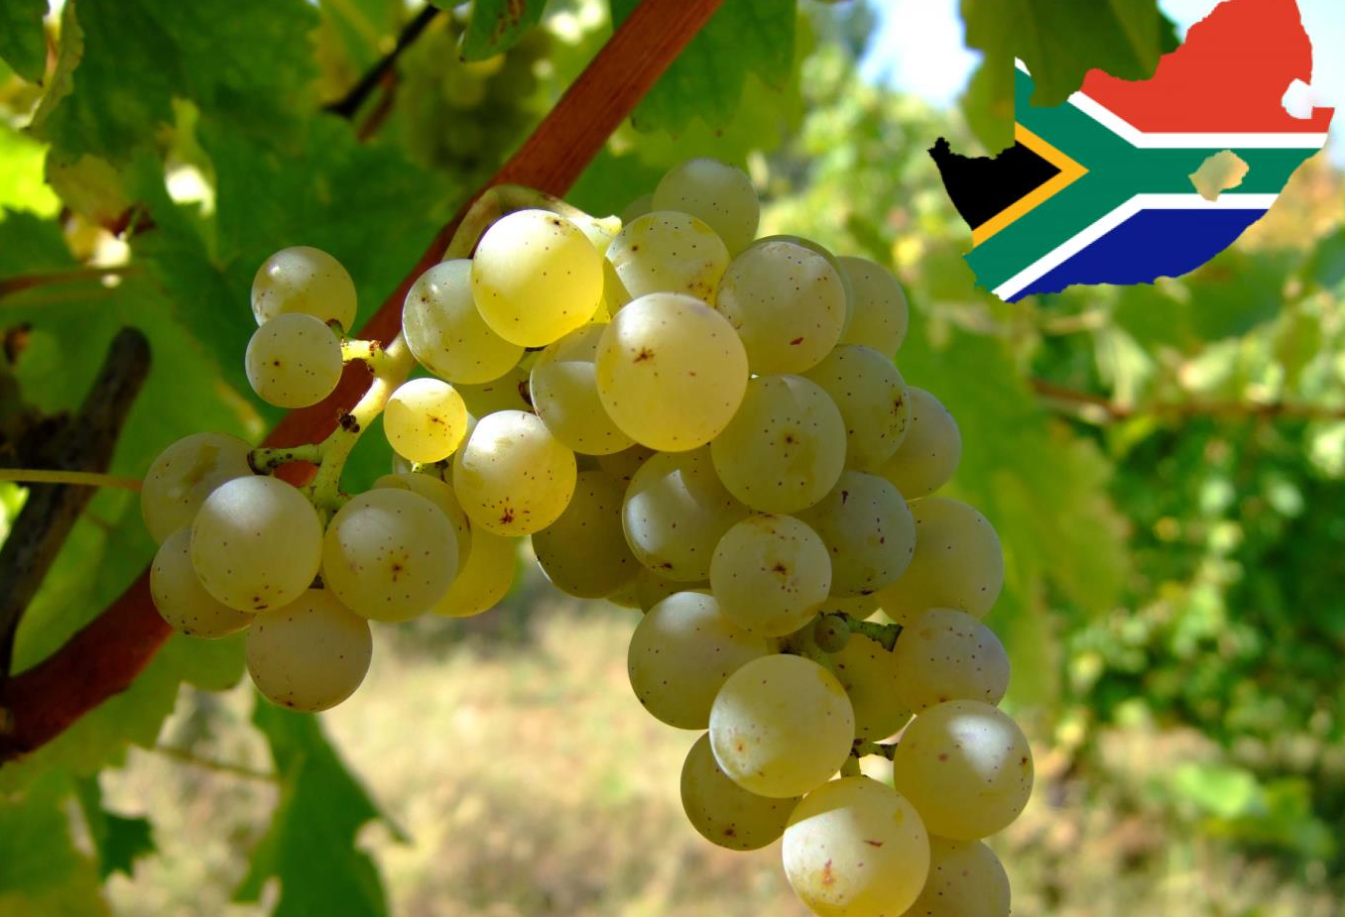
Notes:
If the quality of South African Sauvignon Blanc was generally no more than serviceable just over a dozen years ago, it is now one of South Africa’s strongest categories, having benefited in particular from the modern quest to identify more cool-climate vineyard sites.

Slide 15

Notes:
The style of South African Sauvignon Blanc has diversified to include wines with good fruit expression, in addition to the well-known grassy examples.

Slide 16
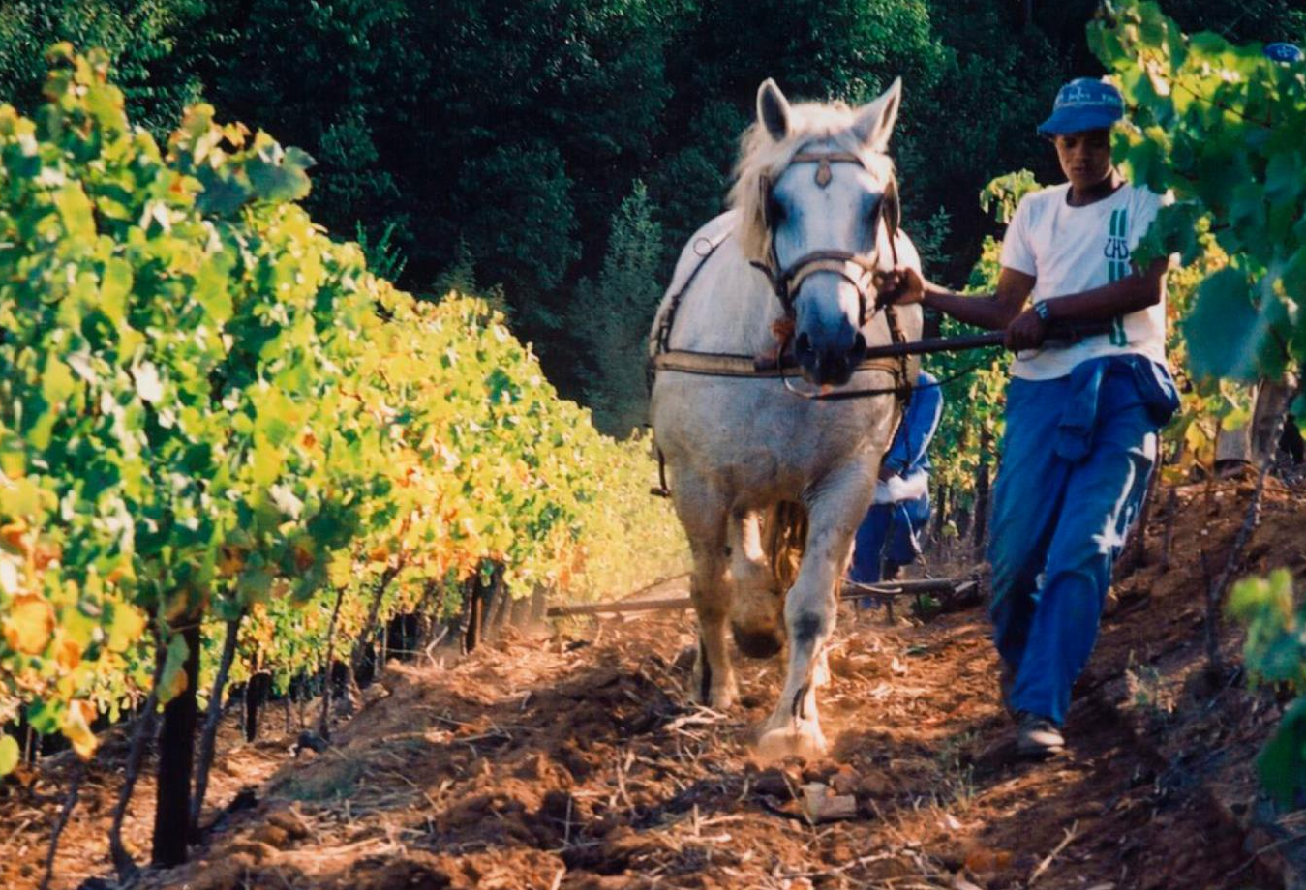
Notes:
Balanced fruit acids are a sought-after attribute. These days South African Sauvignons are well balanced thanks to vineyards being located in areas that allow optimal ripeness.

Slide 17
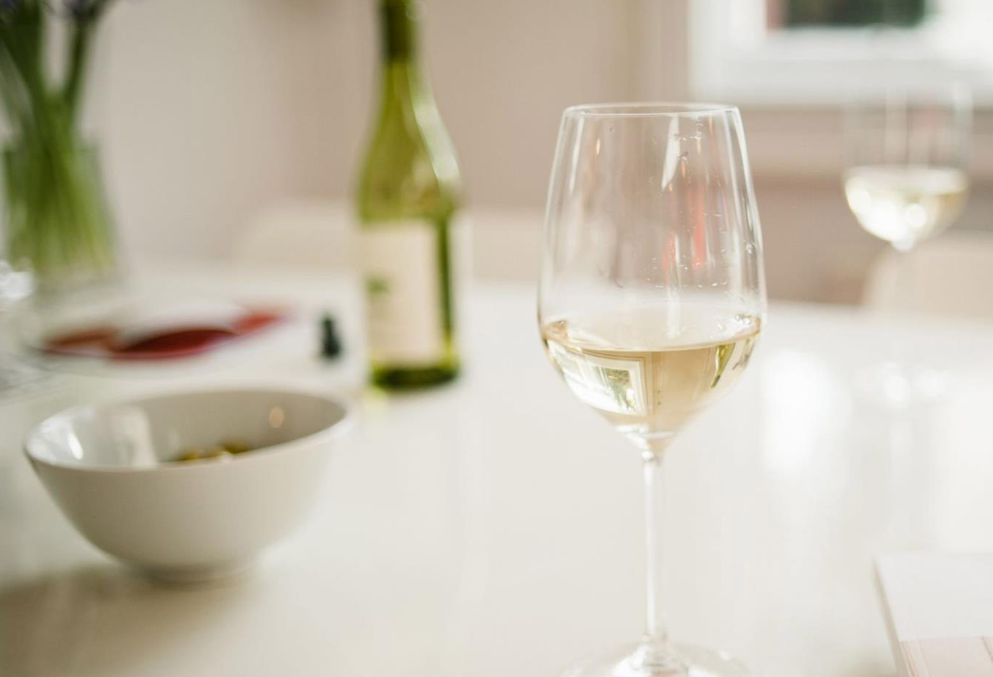
Notes:
Sauvignon wines representing a great diversity of origins and styles are showing the true potential of this noble grape variety in South African conditions.

Slide 18
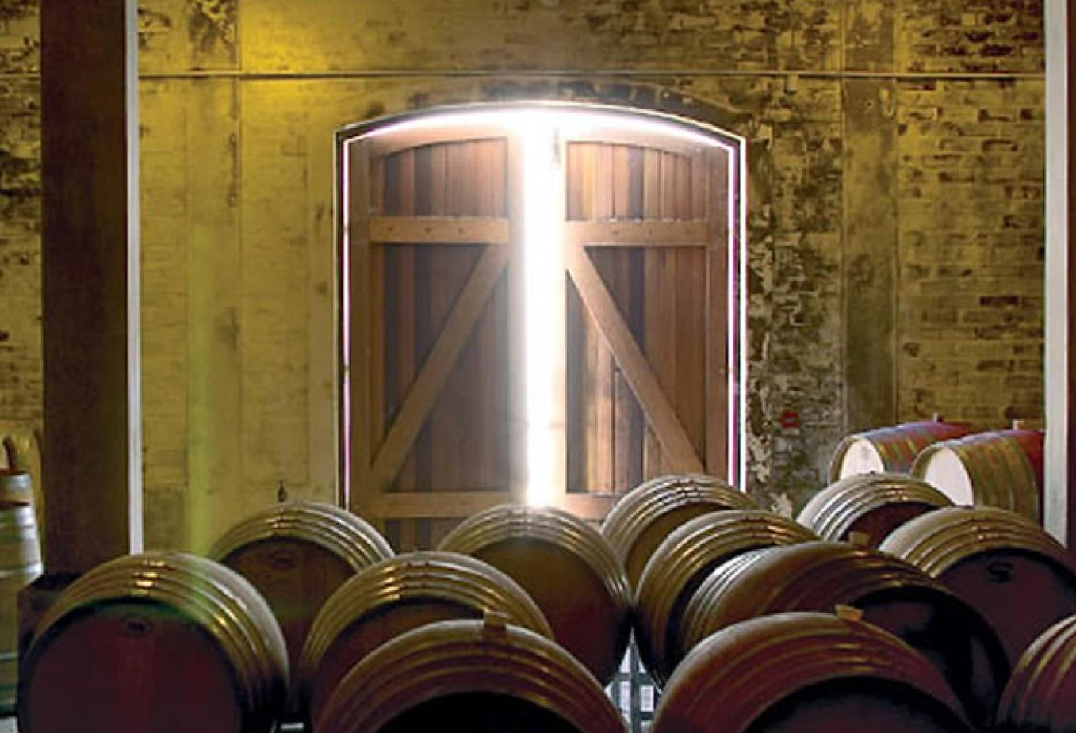
Notes:
The wines are sometimes wooded with clever use of oak adding greater palate weight. These are labelled Fumé Blanc or Blanc Fumé.

Slide 19
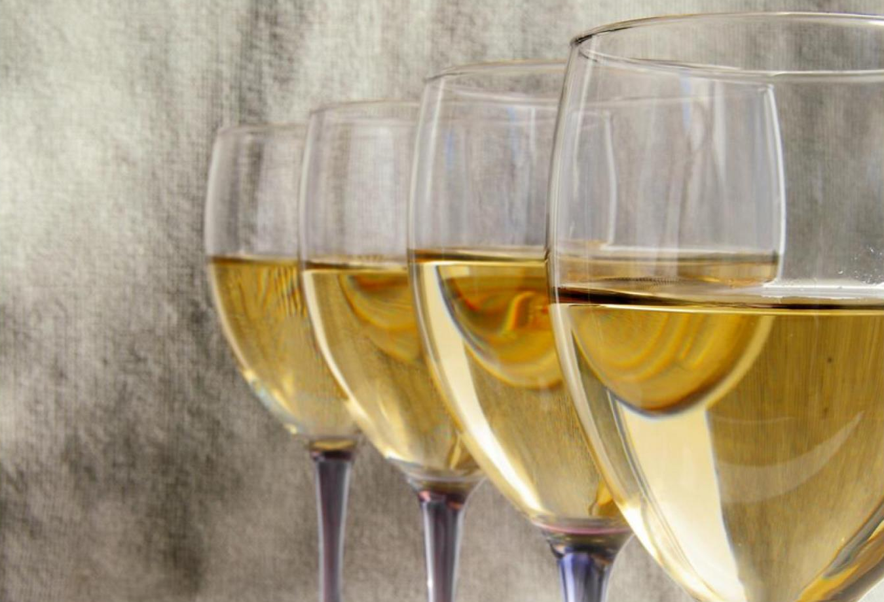
Notes:
Sauvignon Blanc also features in white blends, including in a typically Bordeaux-style blend with Semillon, or a number of other varieties including Chardonnay and Chenin Blanc.

Slide 20
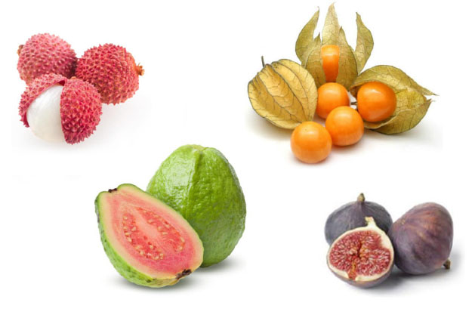
Notes:
Flavour profiles vary from fruit-forward wines – fig and gooseberry or more tropical tones such as guava and litchi – to a distinctive green peppery or grassy character and the more linear flinty and mineral examples.

Slide 21
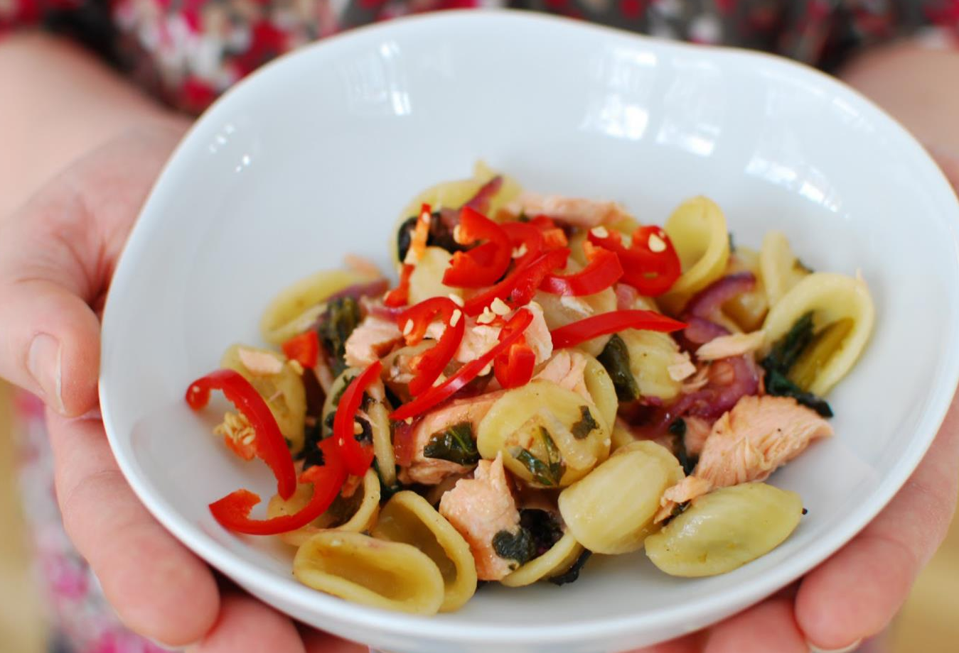
Notes:
Sauvignon works well with a wide range of dishes, from Mediterranean-style appetisers to fish and shellfish dishes and seafood salads, roast chicken or chicken pie, or pasta with pesto.

Slide 22

“Sauvignon Blanc‘s real strength
lies in the diversity of our regions,
the vision of our winemakers,
and the inspiring range of styles
that they create.”
– Elunda Basson, cellarmaster at Steenberg Vineyards and
chairperson of Sauvignon Blanc South Africa

Slide 23
The end
Notes:
The end

